Slide 1
Epi 510: Introduction to R #9 Measures of association & stratified analysis
Jeff Stanaway

Slide 2
Let’s read in vipcls & clean up missing & extreme values
# Store the working directory as an object
dataDir <- "C:/epi510/r/data/"
# Read in vipcls
vipcls <- read.csv(paste0(dataDir, "vipcls.csv"))
# Set all -1 values to missing
vipcls[vipcls==-1] <- NA
# Set mother's age (momage) of 15 to missing
vipcls$momage[vipcls$momage==15] <- NA
# Set gestational age (delges) above 52 to missing
vipcls$delges[vipcls$delges>52] <- NA
# Set birth weight of babies (bw) below 300 or 6000 and above to missing
vipcls$bw[vipcls$bw<300 | vipcls$bw>=6000] <- NA

Slide 3
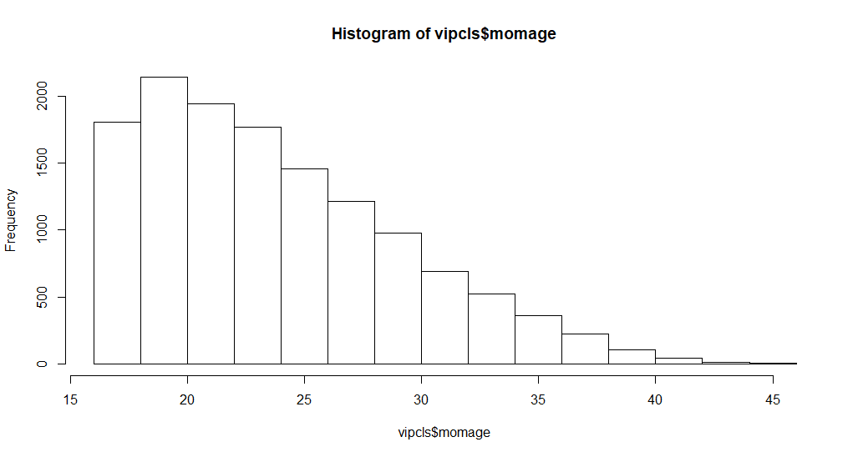
Histograms
hist(vipcls$momage)

Slide 4
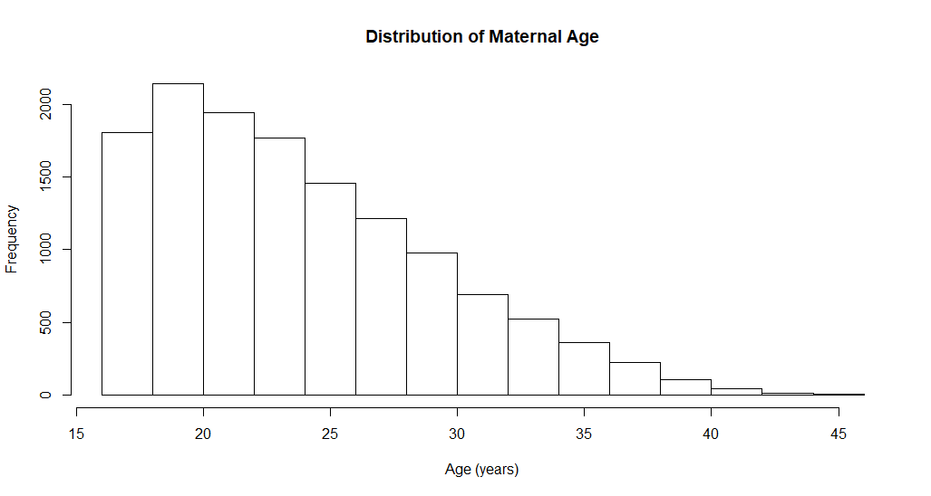
Histograms
hist(vipcls$momage, xlab = "Age (years)", main = "Distribution of Maternal Age")

Slide 5
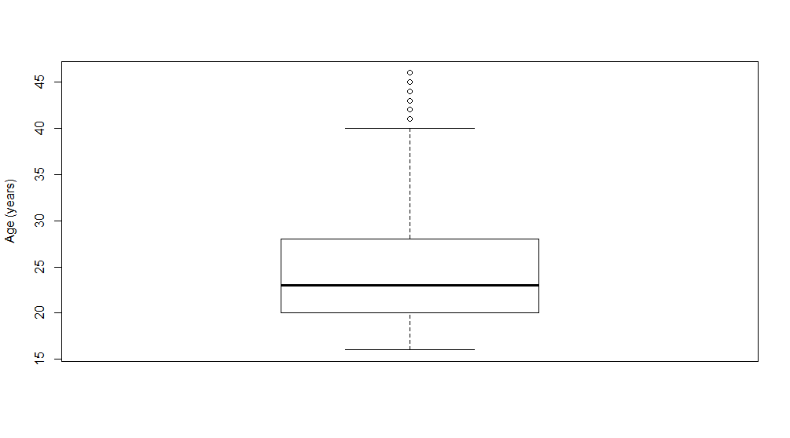
Boxplots
boxplot(vipcls$momage, ylab = "Age (years)")

Slide 6
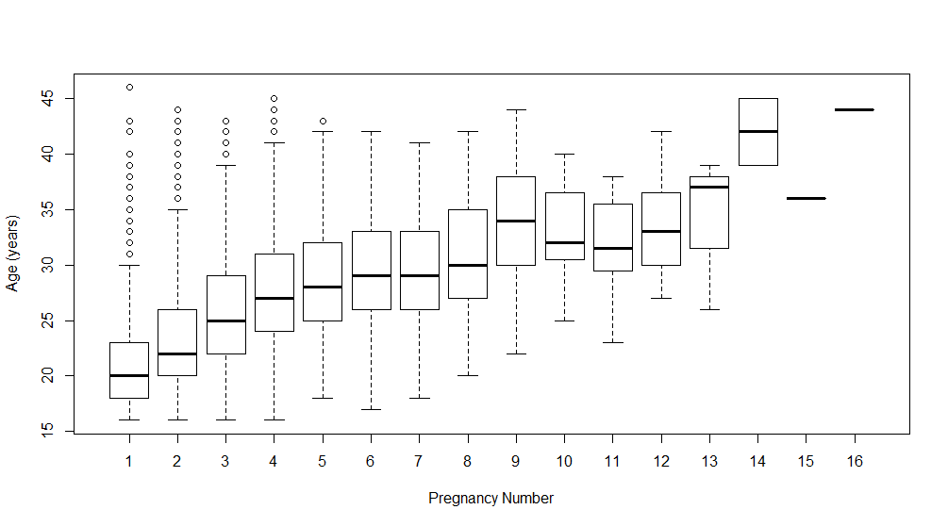
Boxplots
boxplot(vipcls$momage ~ vipcls$pregnum,
ylab = "Age (years)", xlab = "Pregnancy Number")
Notes:
Default in r – categorical variable will be on x axis, distribution being summarized will be on y axis (maternal age)

Slide 7
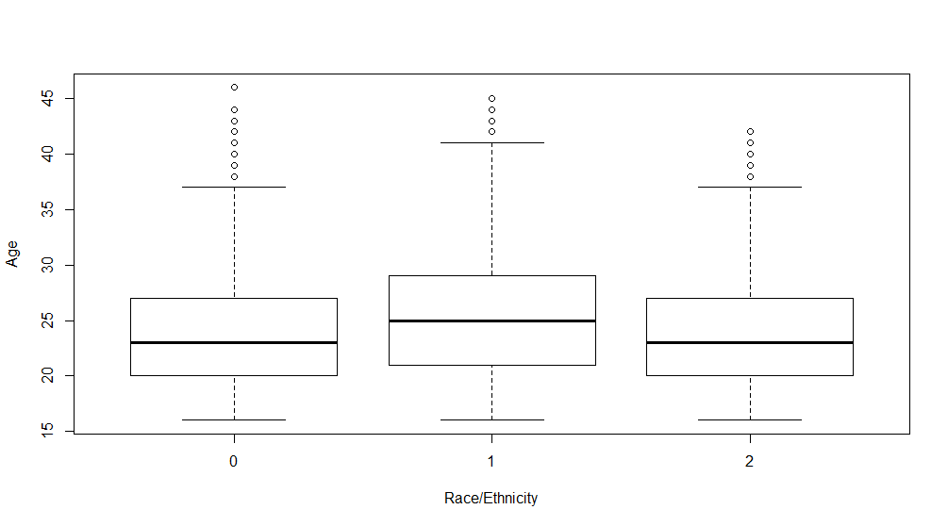
Boxplots
boxplot(vipcls$momage ~ vipcls$raceth, ylab="Age", xlab="Race/Ethnicity“)

Slide 8
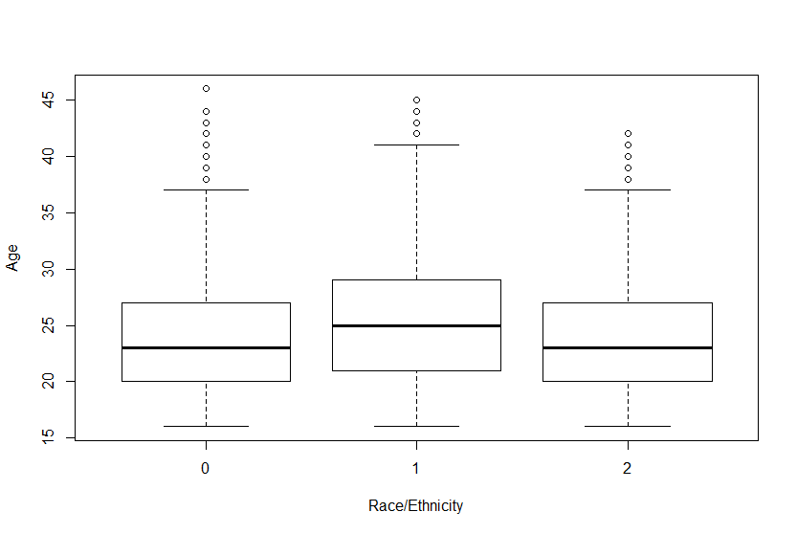
Boxplots
boxplot(vipcls$momage ~ vipcls$raceth, ylab="Age", xlab="Race/Ethnicity“)
Two ways to label the x-axis:
We can specify the labels as an option in the boxplot command
We can convert raceth to a labelled factor variable

Slide 9
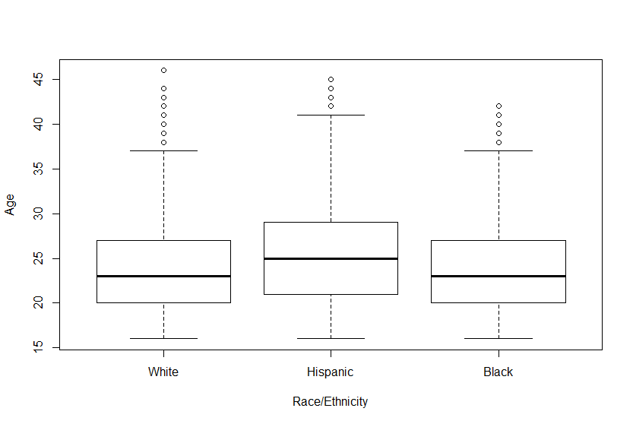
Boxplots
boxplot(vipcls$momage ~ vipcls$raceth, ylab="Age", xlab="Race/Ethnicity", names=c("White", "Hispanic", "Black"))

Slide 10
Boxplots
vipcls$raceth <- factor(vipcls$raceth, levels = c(0:2),
labels = c("White", "Hispanic", "Black"))
boxplot(vipcls$momage ~ vipcls$raceth, ylab="Age", xlab="Race/Ethnicity“)

Slide 11
Relative risks & odds ratios in R
Use epiR package:
install.packages("epiR")
library("epiR")
Ensure variables are correctly coded:
1 = exposed /cases
2 = unexposed / controls
Create 2x2 table
Feed 2x2 table to epi.2by2 function

Slide 12
Stratified analysis example
We want to look at the association between any smoking in the first trimester and premature birth
We'll start by creating three variables:
Premature birth: defined as gestational age < 37 weeks
Any smoking in the first trimester
Alcohol consumption more often than once per month in either the first or second trimester

Slide 13
Create prematurity variable
vipcls$premature[vipcls$delges<37] <- 1
vipcls$premature[vipcls$delges>=37] <- 2
vipcls$premature <- factor(vipcls$premature, levels = 1:2, labels = c("Yes", "No"))
#Let's drop that and try another method
vipcls$premature <- NULL
vipcls$premature <- (vipcls$delges>=37) + 1
vipcls$premature <- factor(vipcls$premature, levels = 1:2, labels = c("Yes", "No"))
# Here's a one-line variation on the above
vipcls$premature <- NULL
vipcls$premature <- factor(vipcls$delges>=37, levels = c(F,T), labels = c("Yes", "No"))
Full term births: vipcls$delges>=37 will evaluate to TRUE, with TRUE = 1, 1+1=2
Preterm births: vipcls$delges>=37 will evaluate to FALSE, with FALSE = 0, 0+1=1
Notes:
As logical expressions:
True is = 1
False = 0
+1 for exposed, +2 for unexposed so have to convert if using epiR for RR & OR

Slide 14
table(vipcls$delges, vipcls$premature, useNA = "always")
Yes No <NA>
23 2 0 0
24 8 0 0
25 13 0 0
26 17 0 0
27 26 0 0
28 27 0 0
29 37 0 0
30 33 0 0
31 65 0 0
32 63 0 0
33 133 0 0
34 217 0 0
35 331 0 0
36 555 0 0
37 0 1019 0
38 0 1871 0
39 0 2735 0
40 0 2693 0
41 0 1919 0
42 0 862 0
43 0 340 0
44 0 139 0
45 0 82 0
46 0 46 0
47 0 16 0
48 0 15 0
49 0 6 0
50 0 4 0
51 0 5 0
52 0 1 0
<NA> 0 0 5
Notes:
On left – gestational ages
All ages <37 coded to yes
Anything over 37 coded to no

Slide 15
Creating alcohol variable
vipcls$etoh1perMo <- (as.numeric(vipcls$etoh1)>=5 & as.numeric(vipcls$etoh2)>=5) + 1
vipcls$etoh1perMo <- factor(vipcls$etoh1perMo, levels = 1:2, labels = c("Yes", "No"))
Notes:
Etoh 1 - not alcohol consumption more than 1 per month in 1st tri AND there was not alcohol consumption more than 1x per month in 2nd tri → 0 +1 (how does this know to convert to 0?)

Slide 16
Creating alcohol variable
table(vipcls$etoh1[vipcls$etoh1perMo=="Yes"], vipcls$etoh2[vipcls$etoh1perMo=="Yes"], useNA = "always")
every day 3-5/wk 1/wk <1/wk <1/month never <NA>
every day 24 5 13 8 9 15 0
3-5/wk 3 22 35 23 17 23 0
1/wk 0 8 220 76 104 150 0
<1/wk 1 3 30 313 136 141 0
<1/month 3 1 14 56 0 0 0
never 1 1 36 71 0 0 0
<NA> 0 0 0 1 0 0 4
table(vipcls$etoh1[vipcls$etoh1perMo=="No"], vipcls$etoh2[vipcls$etoh1perMo=="No"], useNA = "always")
every day 3-5/wk 1/wk <1/wk <1/month never <NA>
every day 0 0 0 0 0 0 0
3-5/wk 0 0 0 0 0 0 0
1/wk 0 0 0 0 0 0 0
<1/wk 0 0 0 0 0 0 0
<1/month 0 0 0 0 1222 636 0
never 0 0 0 0 384 9476 0
<NA> 0 0 0 0 0 0 4
Notes:
Top table is those who drank more than 1x per month in first and second tri
Bottom is those who drank less than 1x per month in first and second tri

Slide 17
Creating variable for any smoking in first trimester
vipcls$smokeFirst <- factor((vipcls$cigs1==0)+1, levels = 1:2, labels = c("Yes", "No"))
table(vipcls$cigs1, vipcls$smokeFirst, useNA = "always")
Yes No <NA>
0 0 9376 0
1 179 0 0
2 220 0 0
3 245 0 0
4 158 0 0
5 276 0 0
6 110 0 0
7 88 0 0
8 85 0 0
9 21 0 0
10 812 0 0
Notes:
If cigs 1 = 0 in data (mother did not smoke in first tri), 0 + 1 = true,

Slide 18
Estimate crude RR: create 2x2 table
We want to look at the association between any smoking in the first trimester and premature birth
The epi.2by2 function needs a 2x2 table as an input, configured as:
 |  | Outcome
 |  | + | -
Exposed | + | a | b
 | - | c | d
(rrTab <- table(vipcls$smokeFirst, vipcls$premature, deparse.level = 2))
vipcls$premature
vipcls$smokeFirst Yes No
Yes 488 3418
No 1039 8334
Notes:
Deparse.level = 2 gives variable names on table
If you wrap code in parenthesis r will output table, normally if you assign to an object (rrTab) it won’t show table.

Slide 19
Estimate crude RR: epi.2by2 function
We feed the 2x2 table into the epi.2by2 function to calculate our crude RR
We see that smokers were 1.13 times as likely to have babies born prematurely
(rrStrat <- epi.2by2(dat=rrTab, method="cohort.count"))
Outcome + Outcome - Total Inc risk * Odds
Exposed + 488 3418 3906 12.5 0.143
Exposed - 1039 8334 9373 11.1 0.125
Total 1527 11752 13279 11.5 0.130
Point estimates and 95 % CIs:
-------------------------------------------------------------------
Inc risk ratio 1.13 (1.02, 1.25)
Odds ratio 1.15 (1.02, 1.28)
Attrib risk * 1.41 (0.19, 2.62)
Attrib risk in population * 0.41 (-0.42, 1.25)
Attrib fraction in exposed (%) 11.27 (1.86, 19.79)
Attrib fraction in population (%) 3.60 (0.44, 6.66)
-------------------------------------------------------------------
X2 test statistic: 5.375 p-value: 0.02
Wald confidence limits
* Outcomes per 100 population units
Notes:
Assigning to object rrStrat so that we can work with the data later if we need to.
Incident risk ratio = relative risk – smokers 1.13% more likely to have babies born premature. CI does not cross over 1, so it is significant because it doesn’t cross over null (1).

Slide 20
Confounding
Distortion of effect estimate induced by a third variable that is associated with (and upstream of) both the exposure and outcome
Identify through a priori knowledge, or when adjusted measures of association are meaningfully different from crude measures
Can address in study design (e.g. randomization) or through statistical control (e.g. M-H adjustment in stratified analysis)
Confounder
Older Age
Exposure
Outcome
High BMI
CVD
Notes:
Arrows have to point this way for it to be confounder. If arrow pointed from exposure to confounder it would be a mediator.
If you want to explore the relationship between high bmi and CVD without the distortion of old age,
Rule of thumb: if something changes your outcome by more than 10%, you have confounding

Slide 21
Confounding vs mediation
Mediator
Exposure
Outcome
Blood Pressure
Physical Activity
CVD

Slide 22
Confounding vs Mediation
Depends on perspective/association of interest
Physical activity is a confounder Blood pressure is a mediator
Physical Activity
Blood Pressure
Blood Pressure
CVD
Physical Activity
CVD

Slide 23
Effect Modification
A real biological or social phenomenon by which an association varies by levels of a third variable
Typically assess using M-H test of homogeneity in stratified analysis, or interaction term in regression (statistical significance)
Should report stratum-specific estimates
Sex
Treatment
Blood Pressure
Notes:
Dealing with a situation where we have different relative risks based on a 3rd variable (ex: a drug being more effective for men or women). There’s no distorting or bias going on, it’s just a nuance. Different effectiveness.
How to handle: give RR separately for men and women to capture the effect modification

Slide 24
Stratified analysis: creating the 2x2x2 table
So, does alcohol consumption confound the relationship between smoking and premature birth?
Start by creating the 2x2x2 table
(rrTabStrat <- table(vipcls$smokeFirst, vipcls$premature, vipcls$etoh1perMo, deparse.level = 2))
, , vipcls$etoh1perMo = Yes
vipcls$premature
vipcls$smokeFirst Yes No
Yes 116 757
No 51 639
, , vipcls$etoh1perMo = No
vipcls$premature
vipcls$smokeFirst Yes No
Yes 372 2660
No 988 7692
Notes:
Is alcohol a confounder or an effect modifier?

Slide 25
Stratified analysis: epi.2by2 function
(rrStrat <- epi.2by2(dat=rrTabStrat, method="cohort.count"))
Outcome + Outcome - Total Inc risk * Odds
Exposed + 488 3417 3905 12.5 0.143
Exposed - 1039 8331 9370 11.1 0.125
Total 1527 11748 13275 11.5 0.130
Point estimates and 95 % CIs:
-------------------------------------------------------------------
Inc risk ratio (crude) 1.13 (1.02, 1.25)
Inc risk ratio (M-H) 1.15 (1.04, 1.28)
Inc risk ratio (crude:M-H) 0.98
Odds ratio (crude) 1.15 (1.02, 1.28)
Odds ratio (M-H) 1.17 (1.04, 1.32)
Odds ratio (crude:M-H) 0.98
Attrib risk (crude) * 1.41 (0.19, 2.62)
Attrib risk (M-H) * 1.62 (-0.16, 3.40)
Attrib risk (crude:M-H) 0.87
-------------------------------------------------------------------
Test of homogeneity of IRR: X2 test statistic: 9.294 p-value: 0.002
Test of homogeneity of OR: X2 test statistic: 9.239 p-value: 0.002
Wald confidence limits
M-H: Mantel-Haenszel
* Outcomes per 100 population units
There were 14 warnings (use warnings() to see them)

Slide 26
Stratified analysis: epi.2by2 function
So, does alcohol consumption confound the relationship between smoking and premature birth?
If we want to test to see the percent change with adjustment, we can type the RRs above into our code to make the calculation:
-------------------------------------------------------------------
Inc risk ratio (crude) 1.13 (1.02, 1.25)
Inc risk ratio (M-H) 1.15 (1.04, 1.28)
Inc risk ratio (crude:M-H) 0.98
100 * (1.15 - 1.13) / 1.13
[1] 1.769912
Notes:
If we use 10% guideline and ask “did adjusting for alcohol consumption change our risk by more than 10%” we can calculate. 1.769912% difference isn’t that big of a change.

Slide 27
Stratified analysis: epi.2by2 function
So, does alcohol consumption confound the relationship between smoking and premature birth?
Alternatively, we can pull the crude and adjusted RRs from the model object that we saved. Finding these can take some digging. You can use the str function to sort out the contents of these types of objects
-------------------------------------------------------------------
Inc risk ratio (crude) 1.13 (1.02, 1.25)
Inc risk ratio (M-H) 1.15 (1.04, 1.28)
Inc risk ratio (crude:M-H) 0.98
> (crude <- rrStrat$massoc.detail$RR.crude.wald[1])
est
1 1.126997
> (adj <- rrStrat$massoc.detail$RR.mh.wald[1])
est
1 1.150029
> 100 * (adj - crude) / crude
est
1 2.043657
Notes:
Assigning to an object is a good option if you will continue using this data for accuracy.
Use str to look at data/object for CIs, etc.

Slide 28
Stratified analysis: epi.2by2 function
Alcohol doesn't appear to be a confounder, but might it be an effect modifier?
Use test of homogeneity to see if stratum-specific estimates are significantly different
(rrStrat <- epi.2by2(dat=rrTabStrat, method="cohort.count"))
Outcome + Outcome - Total Inc risk * Odds
Exposed + 298 624 922 32.32 0.4776
Exposed - 862 11034 11896 7.25 0.0781
Total 1160 11658 12818 9.05 0.0995
Point estimates and 95 % CIs:
-------------------------------------------------------------------
Inc risk ratio (crude) 1.13 (1.02, 1.25)
Inc risk ratio (M-H) 1.15 (1.04, 1.28)
-------------------------------------------------------------------
Test of homogeneity of IRR: X2 test statistic: 9.294 p-value: 0.002
Test of homogeneity of OR: X2 test statistic: 9.239 p-value: 0.002
Wald confidence limits
M-H: Mantel-Haenszel
* Outcomes per 100 population units
Notes:
Statistically significant p-value means that the RR of women who consumed alcohol and those who did not are statistically significant.

Slide 29
Stratified analysis: strata-specific estimates
Stratum-specific estimates are significantly different, but what are the actual estimates?!
epi.2by2 returns detailed information beyond what it displays
It looks like the association between smoking and premature birth is substantially stronger among women who also drank at least once per month
rrStrat$massoc.detail$RR.strata.wald
est lower upper
1 1.797723 1.3135318 2.460394
2 1.077895 0.9638536 1.205430
Notes:
RR for level 1 of our third variable (women who DID drink) – ~1.8.
Those who did not drink ~1.08
Association between smoking and premature birth is much stronger among women who drink.

Slide 30
Let's repeat as if this were a case-control study
(orStrat <- (epi.2by2(dat=rrTabStrat, method="case.control")))
Outcome + Outcome - Total Prevalence * Odds
Exposed + 488 3417 3905 12.5 0.143
Exposed - 1039 8331 9370 11.1 0.125
Total 1527 11748 13275 11.5 0.130
Point estimates and 95 % CIs:
-------------------------------------------------------------------
Odds ratio (crude) 1.15 (1.02, 1.28)
Odds ratio (M-H) 1.17 (1.04, 1.32)
Odds ratio (crude:M-H) 0.98
Attrib prevalence (crude) * 1.41 (0.19, 2.62)
Attrib prevalence (M-H) * 1.62 (-0.16, 3.40)
Attrib prevalence (crude:M-H) 0.87
-------------------------------------------------------------------
Test of homogeneity of OR: X2 test statistic: 9.239 p-value: 0.002
Wald confidence limits
M-H: Mantel-Haenszel
* Outcomes per 100 population units
There were 14 warnings (use warnings() to see them)
Notes:
Odds ratio instead of relative risk for case-control study

Slide 31
Stratified analysis: case-control study
Let's check the percentage change in the OR with adjustment:
(crude <- orStrat$massoc.detail$OR.crude.wald[1])
est
1 1.145134
(adj <- orStrat$massoc.detail$OR.mh.wald[1])
est
1 1.17121
100 * (adj - crude) / crude
est
1 2.277068
Note that the object names have changed from RR to OR!

Slide 32
Stratified analysis: case-control study
As before, alcohol is not a confounder (no surprise)
Let's check for effect modification
Point estimates and 95 % CIs:
-------------------------------------------------------------------
Odds ratio (crude) 1.15 (1.02, 1.28)
Odds ratio (M-H) 1.17 (1.04, 1.32)
Odds ratio (crude:M-H) 0.98
Attrib prevalence (crude) * 1.41 (0.19, 2.62)
Attrib prevalence (M-H) * 1.62 (-0.16, 3.40)
Attrib prevalence (crude:M-H) 0.87
-------------------------------------------------------------------
Test of homogeneity of OR: X2 test statistic: 9.239 p-value: 0.002
Wald confidence limits
M-H: Mantel-Haenszel
* Outcomes per 100 population units

Slide 33
Stratified analysis: case-control study
So, the test of homogeneity indicates a significant difference in ORs between strata
Let's pull the stratum-specific estimates
orStrat$massoc.detail$OR.strata.wald
est lower upper
1 1.919963 1.3587727 2.712931
2 1.088789 0.9588228 1.236371

